Slide 1
Deep Learning
Renesas

Slide 2
Agenda
Introductions
Content Walkthrough
Q & A

Slide 3
Introduction
Survesh has been with Udacity from last 4 years and have mentored in the area of Deep Learning, Data engineering and Data science
Linkedin - https://www.linkedin.com/in/surveshchauhan/

Slide 4
Project 2 : Landmark Classification

Slide 5
Project Steps
The high level steps of the project include:
Create a CNN to Classify Landmarks (from Scratch) - Here, you'll visualize the dataset, process it for training, and then build a convolutional neural network from scratch to classify the landmarks. You'll also describe some of your decisions around data processing and how you chose your network architecture. You will then export your best network using Torch Script.
Create a CNN to Classify Landmarks (using Transfer Learning) - Next, you'll investigate different pre-trained models and decide on one to use for this classification task. Along with training and testing this transfer-learned network, you'll explain how you arrived at the pre-trained network you chose. You will also export your best transfer learning solution using Torch Script
Deploy your algorithm in an app - Finally, you will use your best model to create a simple app for others to be able to use your model to find the most likely landmarks depicted in an image. You'll also test out your model yourself and reflect on the strengths and weaknesses of your model.
Each of these three major steps is carried out in a corresponding Jupyter Notebook that you will be provided in the project starter kit. So there are three notebooks that will guide you in your project work.

Slide 6
Environment and Dependencies [WORKSPACE OR LOCAL]
Option 1: Working in the Udacity project workspace
You can find the Udacity Project Workspace here in your Udacity classroom, on the Project Workspace page.
On the workspace page, when prompted on whether you want a GPU or not, please ANSWER YES (the GPU is going to make everything several times faster).
The environment is already set up for you, including the starter code, so you can jump right into building your project!

Slide 7
Environment and Dependencies [WORKSPACE OR LOCAL]
Option 2: Working locally
Alternatively, you can develop your project locally on your computer. This setup requires a bit of familiarity with creating a working deep learning environment. While things should work out of the box, in case of problems you might have to do operations on your system (like installing new NVIDIA drivers for your GPU) that are not covered in the class. Please work on your local environment only if you are at least a bit familiar with these subjects, otherwise we recommend using the provided Udacity workspace in the classroom.
Download the starter kit from the Resources section of the left sidebar of the Udacity classroom here. (Scroll down if you don't see it.)
Open a terminal and navigate to the directory where you installed the starter kit.
Download and install Miniconda
(opens in a new tab)
Create a new conda environment with Python 3.7.6:

Slide 8
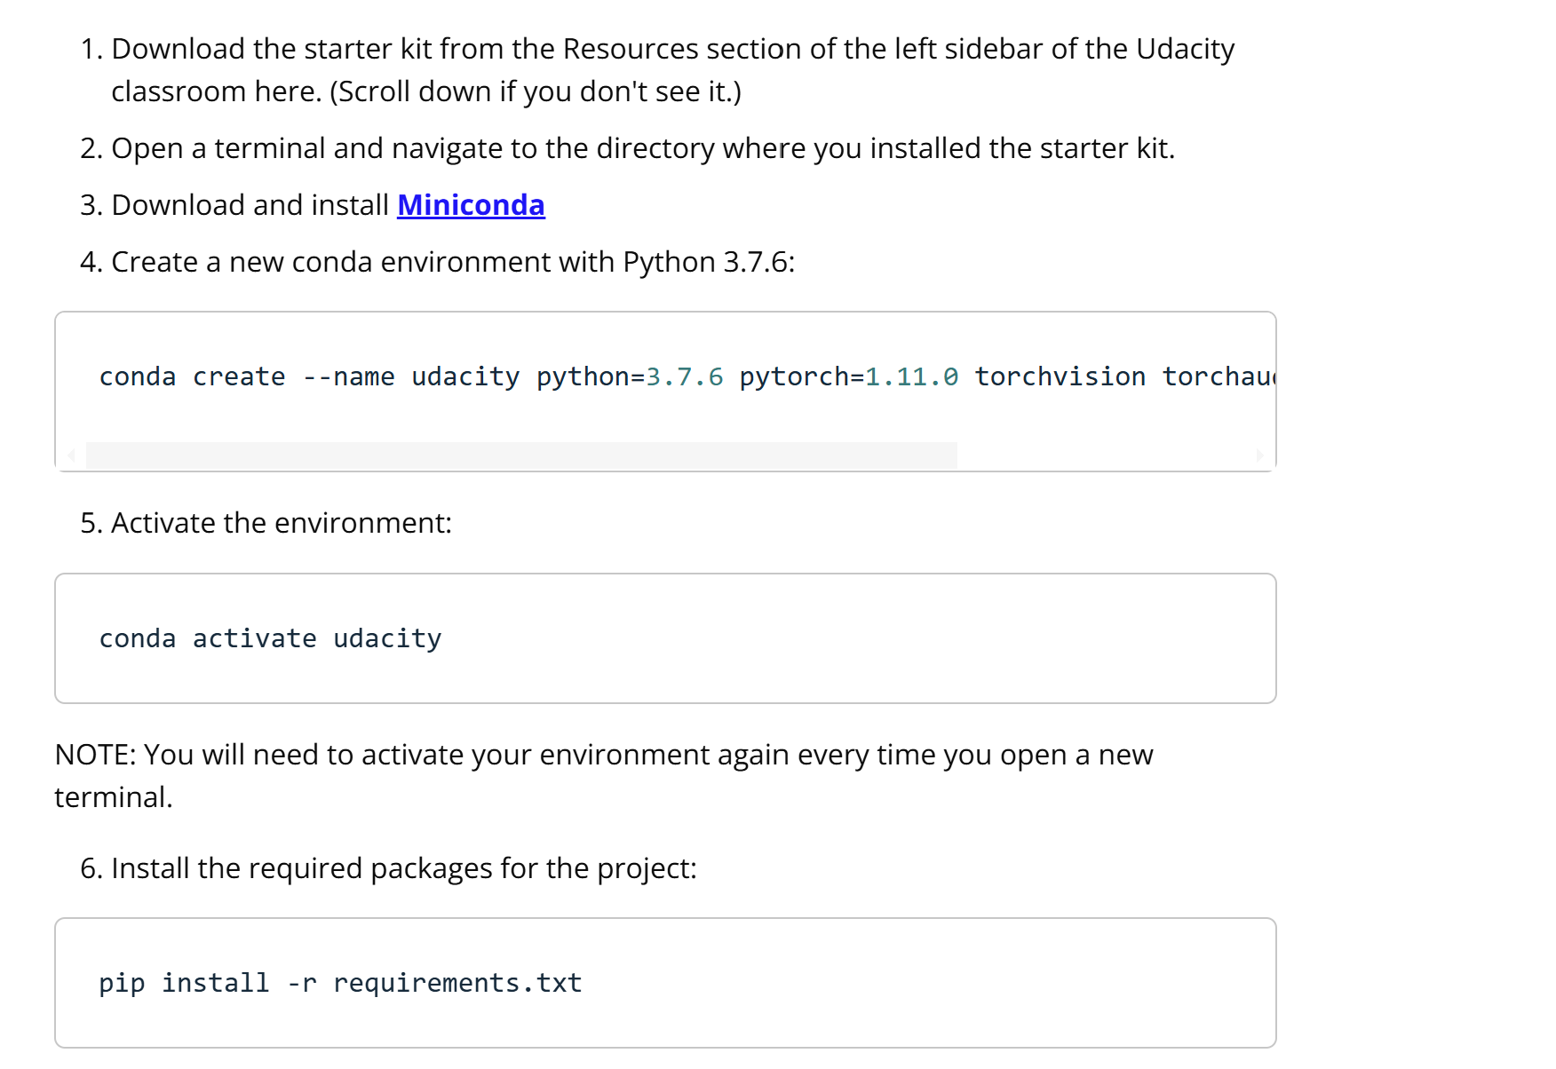
Environment and Dependencies [WORKSPACE OR LOCAL]

Slide 9
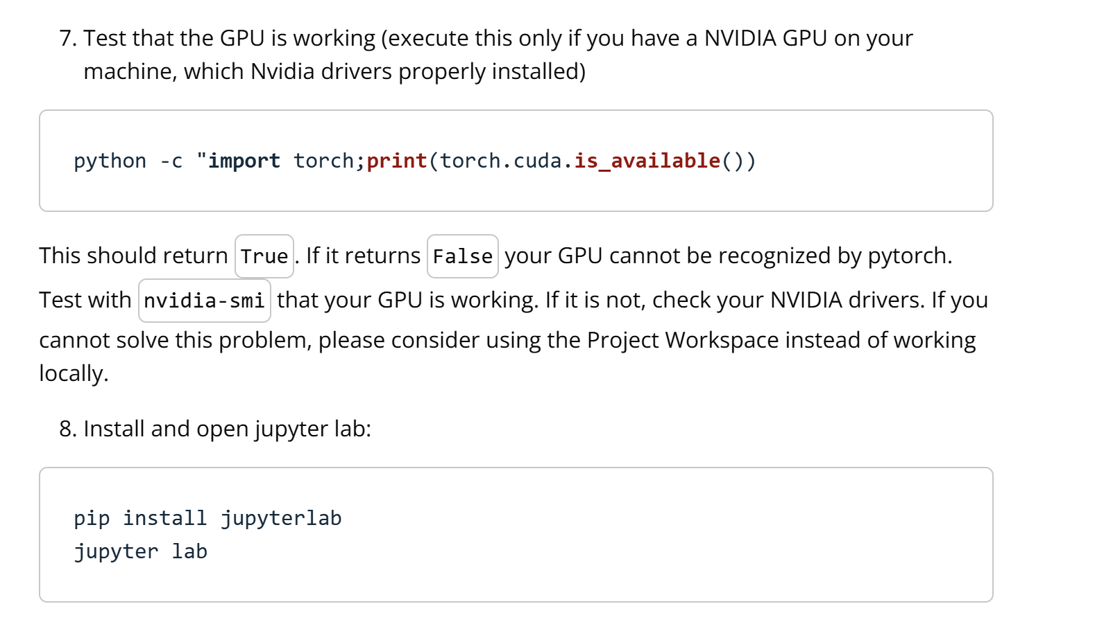
Environment and Dependencies [WORKSPACE OR LOCAL]

Slide 10
Rubrics

Slide 11
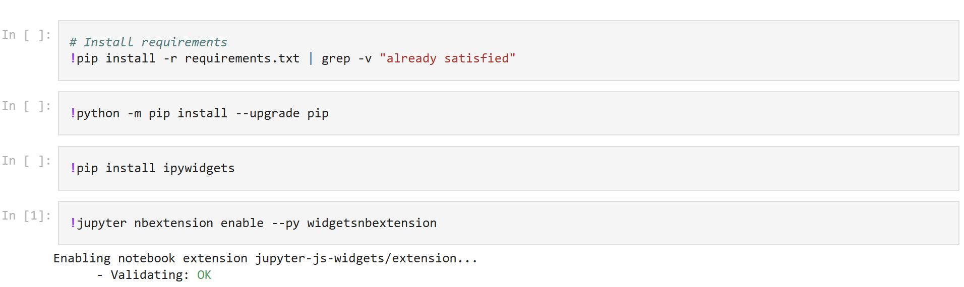
Tips and suggestion
import Ipython
IPython.Application.instance().kernel.do_shutdown(True) #automatically restarts kernel
Use num_workers=2/4 to speed up the training process
Use 4-5 CNN and 2-3 dense layer as classifier
Use batch size of 16-32, dropout 0.2 to 0.3, adam optimizer with 0.001 learning rate
For Transfer learning, use resent 18 and it should be good enough
For app to work,
https://github.com/Surveshchauhan/Udacitystudent/blob/main/app1.ipynb
https://poloclub.github.io/cnn-explainer/
https://netron.app/
Notes:
import Ipython
IPython.Application.instance().kernel.do_shutdown(True) #automatically restarts kernel

Slide 12
Project 4 : Face Generation

Slide 13
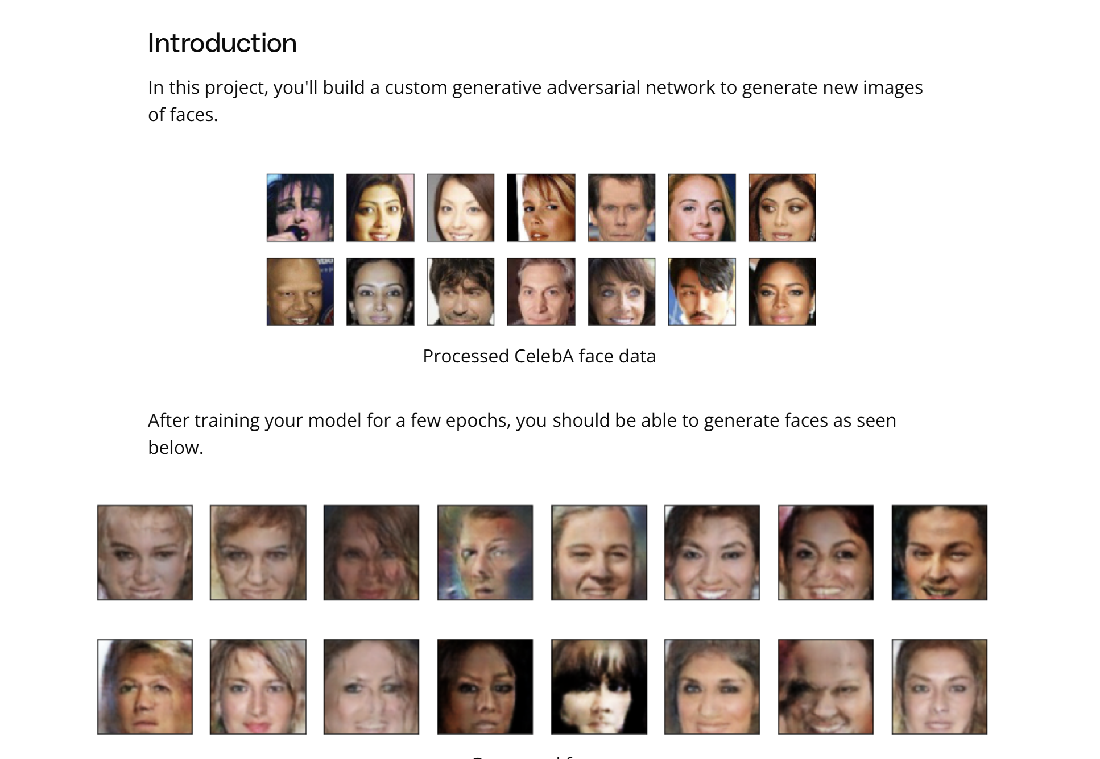
Introduction

Slide 14
Project Instructions
The project files are located in the Project Workspace and include the following files:
dlnd_face_generation_starter.ipynb
README.md
requirements.txt
tests.py
processed-celeba-small.zip
We highly recommend using the Project Workspace to complete your project; however, if you choose to not use the workspace, you can download the project files from the Project Workspace.

Slide 15
Project Instructions
Instructions
Open the notebook file, dlnd_face_generation_starter.ipynb and follow the instructions. This project is organized as follows:
Data Pipeline: implement a data augmentation function and a custom dataset class to load the images and transform them.
Model Implementation: build a custom generator and a custom discriminator to make your GAN
Loss Functions and Gradient Penalty: decide on loss functions and whether you want to use gradient penalty or not.
Training Loop: implement the training loop and decide on which strategy to use
Each section requires you to make design decisions based on the experience you have gathered in this course. Do not hesitate to come back to a section to improve your model or your data pipeline based on the results that you are getting.
Building a deep learning model is an iterative process, and it's especially true for GANs! Good luck!

Slide 16
Rubrics

Slide 17
Tips and suggestion
4-5 Layer CNN for Discriminator with Batch norm and leaky relu
4-5 Layer ConvTranspose2d for Generator with Batch norm and leaky relu and TANH at the last layer
n_epochs = 10
batch_size = 16 to 64
num_workers=2/4

Slide 18

Q&A

Slide 19
Thank you

